Slide 1
TRADE TUNNEL
TRADE IT YOUR Way....
Himanshu Chhabra
Aarsh Patil
Chetali Mahore
Vinu Kundnani
Krupa Mavani
Sowmya Padmanabhi
Sonali Ratnam
Anagha Fatale

Slide 2
Introduction
Trade tunnel allows users to seamlessly buy and/or sell their products.
It is very common to sell used products which are not needed anymore
Trade Tunnel gives a real-time opportunity to meet potential buyers
This organized platform bridges the gap between buyers and sellers to trade stuff online.

Slide 3
Motivation
It is very common for students to use social media to advertise products they want to sell. However, meeting potential buyers is laborious.
Trade Tunnel addresses this issue and provides a very convenient solution as a mediator between a seller and a potential buyer.
Originally, the target audience considered for this web application was SU students, however we decided to go beyond SU boundaries.

Slide 4
Lets Talk About Features !!

Slide 5
Login feature
The web application provides sign in options.
Custom Login options allows the user to get started with the application
Custom registration allows the user to get registered to the application

Slide 6
Forgot Password feature
The web application provides account recovery feature.
On clicking on the forgot password button in the login page, the user is requested for its email Id, an account recovery link is sent on the users email id.
The link allows the user to reset the password.

Slide 7
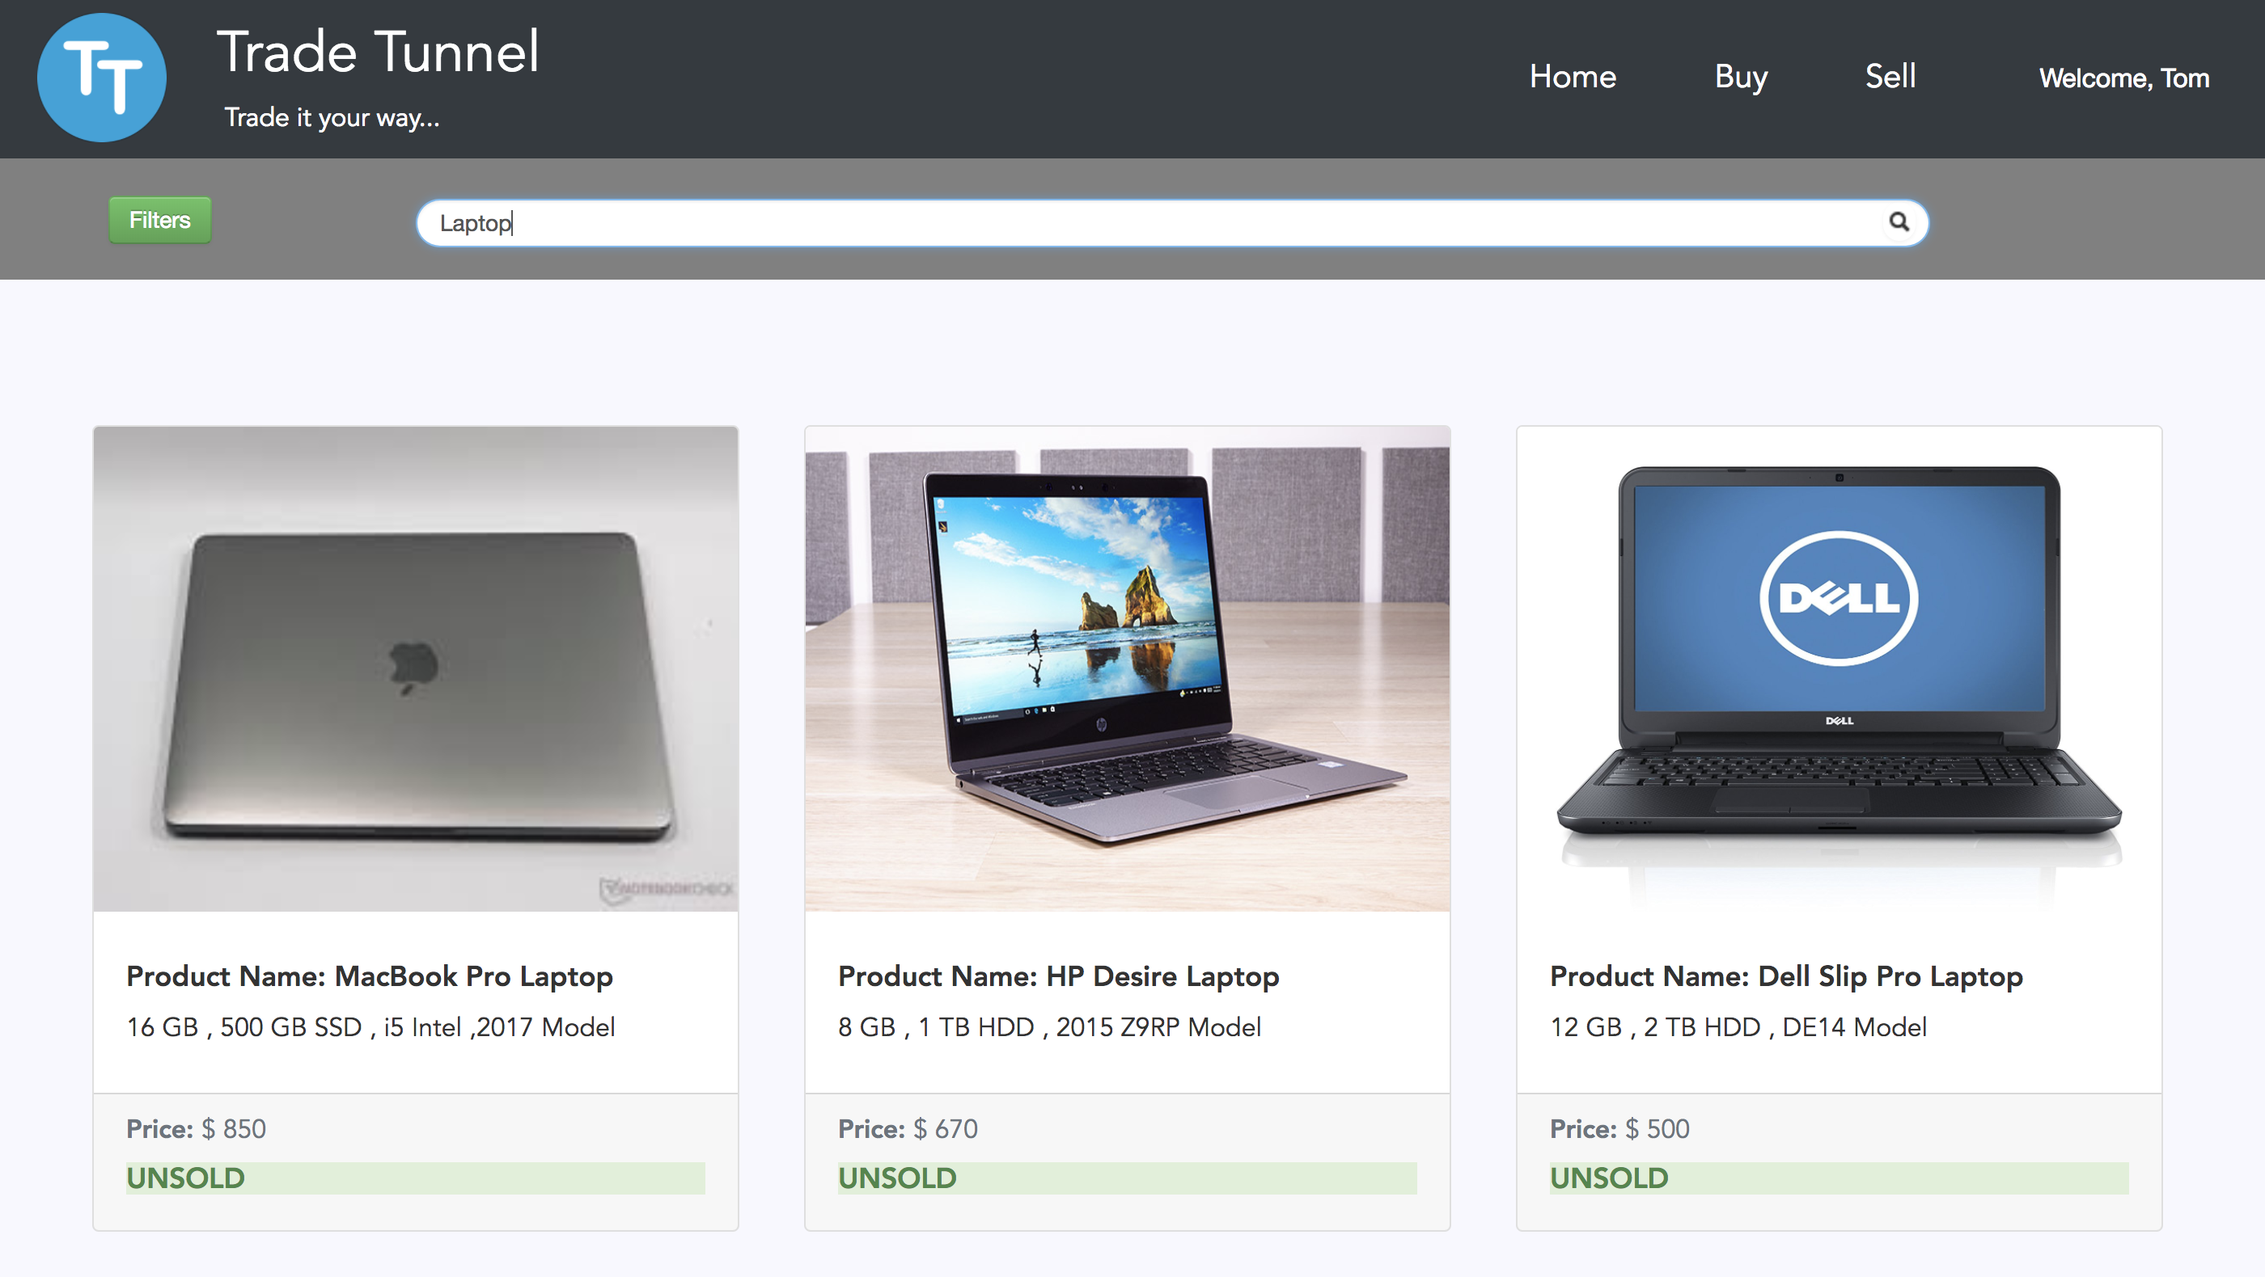
Advance search feature
The application provides advance search feature enhancing user experience by allowing them to search for products using keywords.
Eg: Laptop, table, iPhone, shoes, headphones etc.

Slide 8
Filter feature – buyers View
User can browse through multiple products based on many filters such as:
Categories - allows the user to filter products based on categories.
Sub-categories - allows the user to filter products based on sub-categories.
Price range - allows the user to filter products within the price range.
Location based service - allows the users to view products at a particular location.
These filters can be used in conjunction providing better user experience.

Slide 9
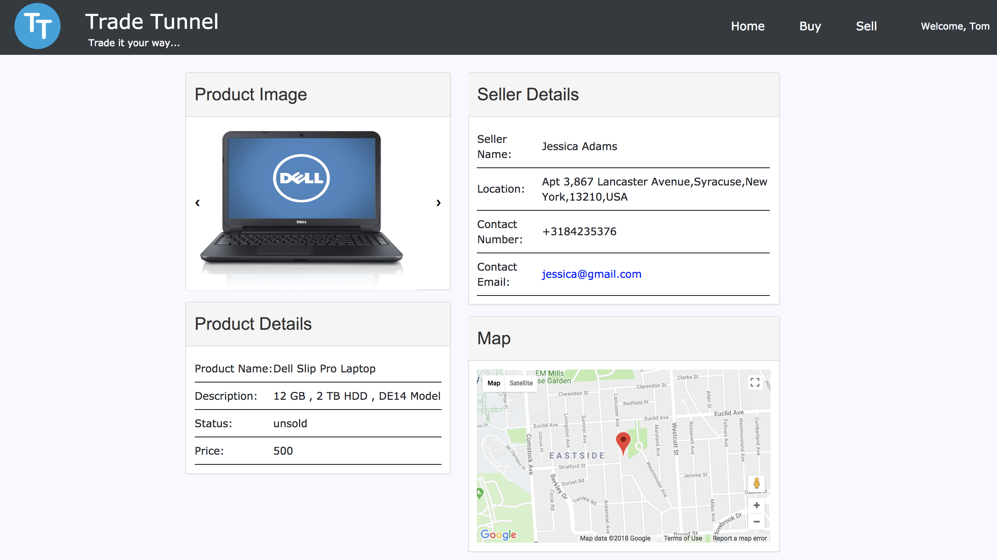
I’m interested (Notification feature) Locate Me the Seller (Google Maps Assistance)
Buyer can use the instant email functionality provided to contact the seller immediately by clicking on the email address of the seller.
Google Maps Assistance Feature, Helps the Buyer to locate the Seller on the Map using sellers address

Slide 10
Product advertisement feature (sellers View)
This application provides an opportunity for the users to
Advertise their products , with an eye - catchy description
Categorize and Sub categorize their products
Upload images of the product
Provide competitive costs for their products

Slide 11
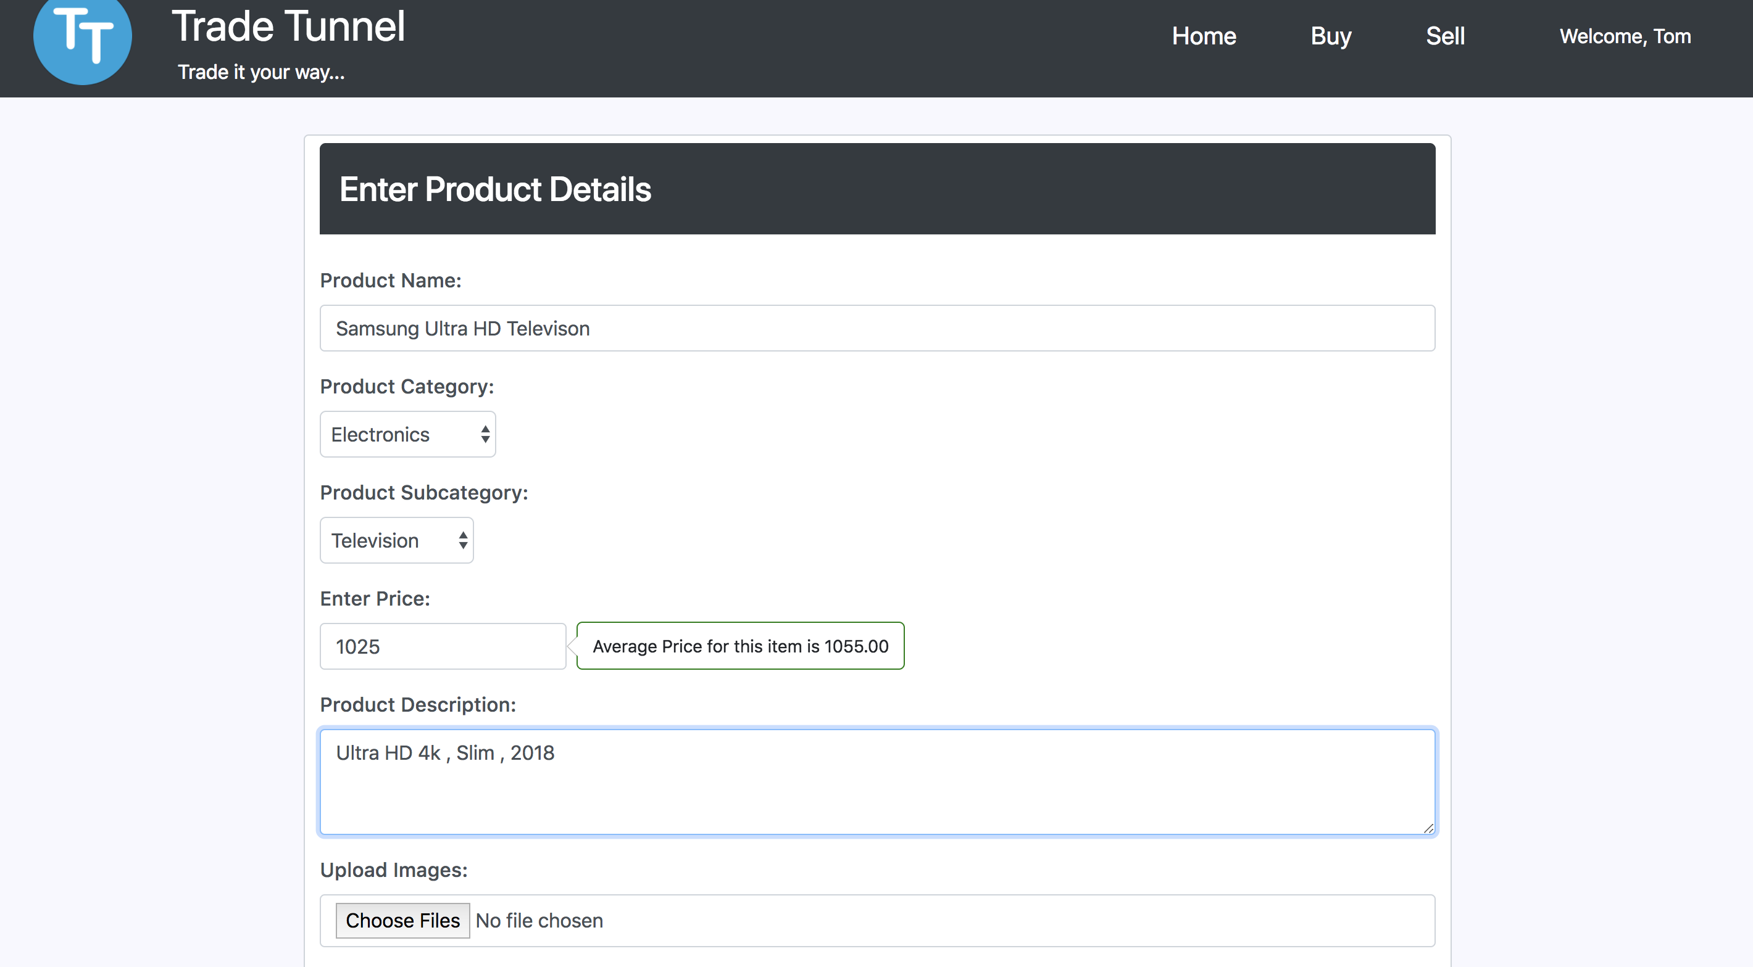
Price assistance feature:
Price assistance feature: Application assists the user to set a competitive price for the product by displaying the average price of the product in the selected sub category.

Slide 12
We Maintain You (User Profile Feature)
Users can view and update personal information such as name, phone number, address.
The application maintains a history of users products
The user can update details about the products advertised such as
Product name
Description
Price
Update product status (sold/unsold)

Slide 13
Lets get into Some TECH!!

Slide 14
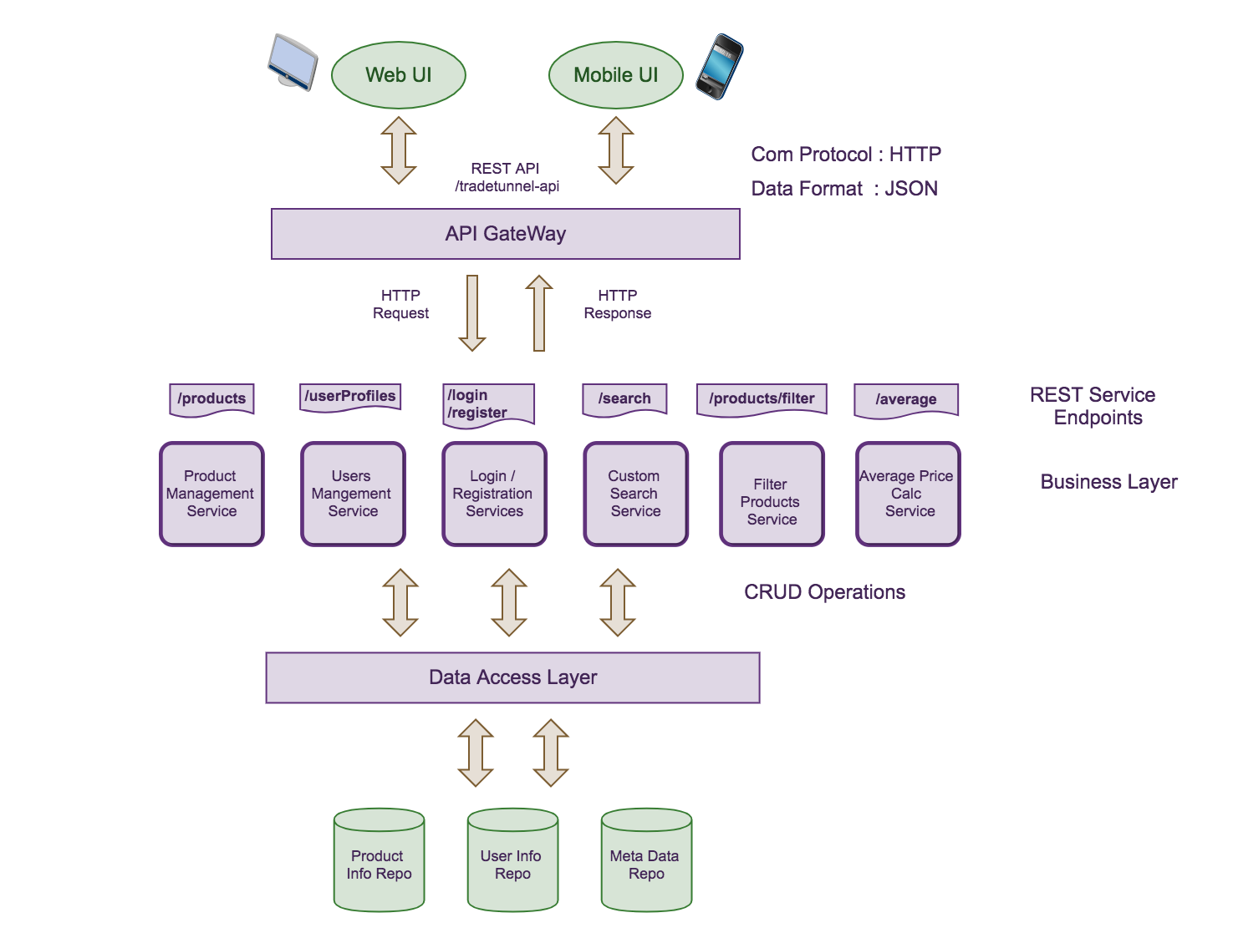
SYSTEM
ARCHITECTURE

Slide 15
Technologies used
Frontend Technologies: - HTML 5, CSS 3, Bootstrap 4 , Javascript , AJAX , jQuery
Backend Technologies: – Spring Boot, Spring Data REST (Micro-Services) ,Spring ORM (Hibernate)
Relational Database: MySQL Data base, MySQL Workbench as a client for MySQL Db
Application Server: Tomcat 9
Building Tool: Maven
Version control: Bitbucket

